Slide 1



🌸 Cosmo
Code First Girls – Nanodegree – SOFTWARE 2
Cosmetics Search Engine by Ingredients
Project Group2

Slide 2
Outline
Introduction
Databases
Functions (DB_Utils & API)
Website UI
TestING
Demo
Conclusion

Slide 3








Intro
What is Cosmo?
Web Application:
Back End: Python, SQL
Front End: HTLM, CSS, javascript
Cosmetics multi-criteria Search Engine by Ingredients
FROM Open Beauty Facts COSMETICS Database
(Open FooD Facts subproject)

Slide 4
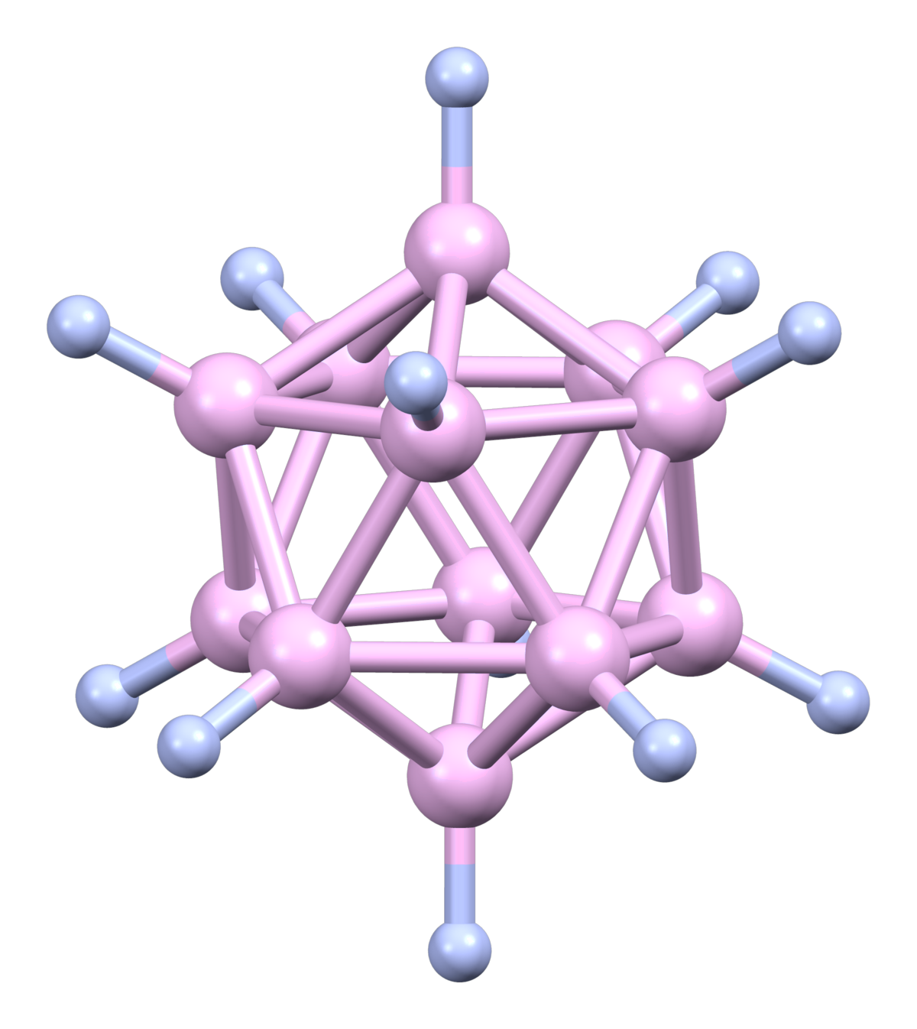




Intro
Why Cosmo?
😱😭
NIGHTMARE SCENARIO: YOUR FAVOURITE PRODUCT IS DISCONTINUED!
How to find a replacement?
Cosmetics = Chemical recipe
Ingredient list: order matters!
1st ingredient: highest concentration
Last ingredient: Lowest concentration
Open Beauty Facts (OBF), INCI…
Large databaseS
Search Engines
but ingredient order not taken into account!

Slide 5
Intro
Why Cosmo?
User stories
I have [acne prone skin], I need to find products with [salicylic acid] in it.
As [an allergic person], I need to find products without [parabens] in it so [I don’t die from a bad rash]
I want a product with [X as 1st ingredient] and [Y as 2nd ingredient]
I am a [skincare junkie and a cosmetics nerd], I want a product with [ingredients X,Y and Z] but without [ingredient U].
…
I want products I select to be saved in my wishlist so I don’t lose them

Slide 6


Intro
Main Features
Users side
Sign up/Create account
log in/LOG OUT
Products side
Search for products (multi-criteria)
Display Results
Wishlist side
save selected products to User wishlist
Manage wishlist items

Slide 7
Intro
Application Diagram
Products
DB
Products
DB Utils
API
Website UI
Wishlist
DB Utils
Users &
Wishlist
DB
Users
DB Utils

Slide 8

Intro
Libraries
mysql.connector
mysql.connector to connect to SQL DB
flask micro web application framework
flask-cors Cross Origin Resource Sharing (CORS): required for the frontend to send requests
json used to write the API
requests used to write the API
pandas used to clean up the OBF DB
numpy used in the ListDF homemade module (to apply functions on whole dataframe columns)
pprint to display messages to the terminal while debugging/testing
unittest for testing
unittest.mock for testing
operator for testing
pathlib to represent paths for OOP
sys to add folders to the Python path so other scripts can be importeD
flask
flask-cors
json
requests
pandas
numpy
pprint
unittest
unittest.mock
operator
pathlib
sys
Notes:
Creating a web app such as Cosmo as a team proved a very enriching, teaching and rewarding project, although sometimes challenging, both on a technical and interpersonal/organisational level. Our product is still a prototype, and could certainly be improved, but it fulfils our basic requirements, and other features could now be incrementally added to it.

Slide 9
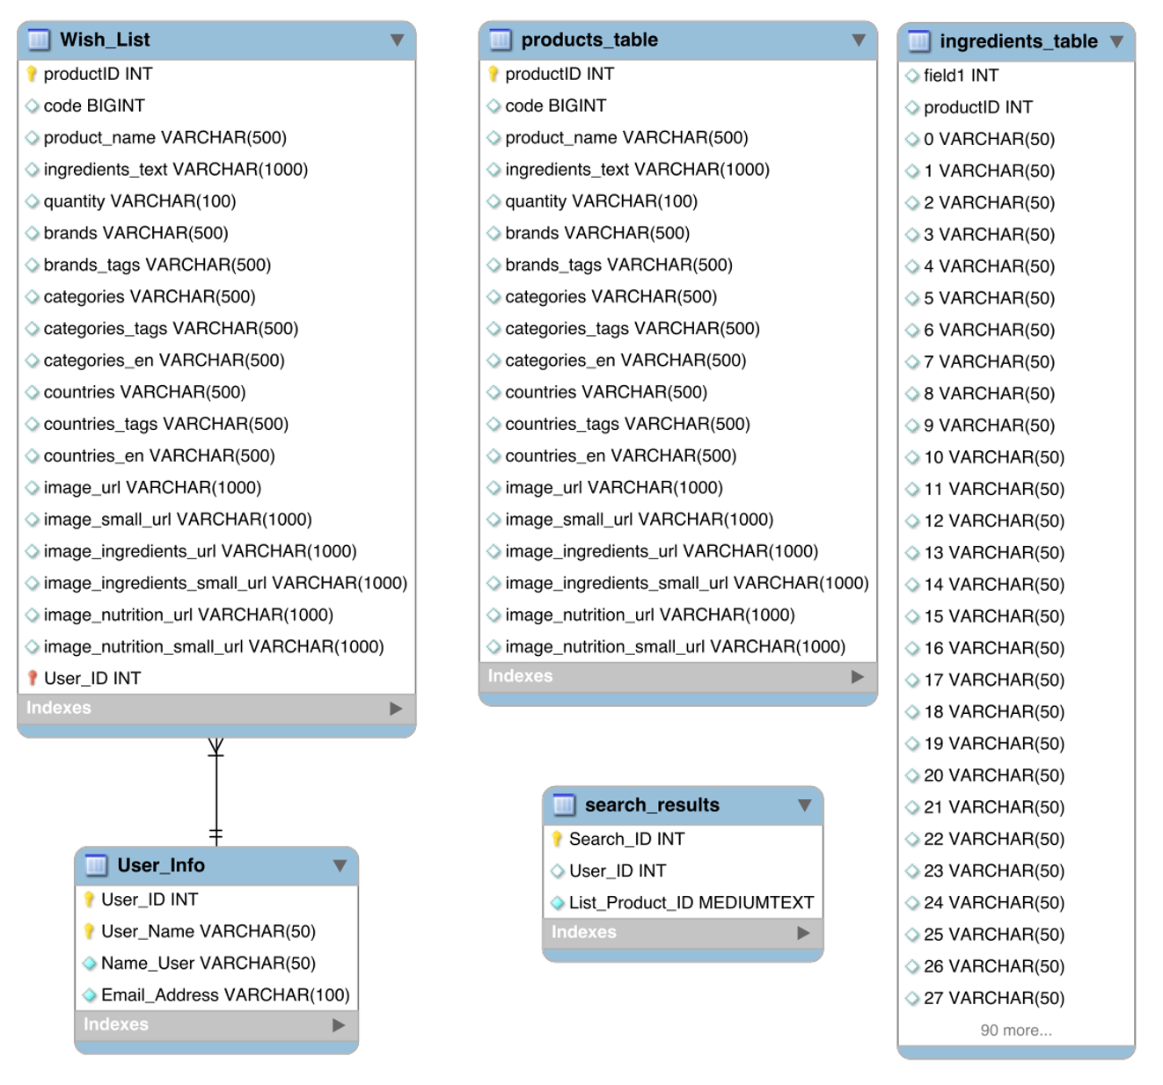
Databases EER* Diagram
DB
2 Databases
Products DB
Products table
Ingredients table
Search table
Users & Wishlist DB
Wishlist table
Users table
* EER: Enhanced Entity-Relationship

Slide 10

Products DatabasE
DB
OBF DB
Cosmo DB
Clean Tables
Products Table
🌸
OBF Table
ListDF Module
+
Ingredients Table
Modified OBF DB → COSMO DB
Products table
Ingredients table = 1 column/ingredient, ordered
Search Table
Search Table
Notes:
Originally, we intended to use the Open Beauty Facts (OBF) DB indirectly by consuming their API, but as it was still very experimental, barely documented, and did not actually work for our purpose since it only offered the possibility to search for products barcodes, we changed our minds and resolved to use the OBF database differently. At the beginning, we even considered webscraping it, but it was not practical, and eventually we settled for downloading it as a CSV file. We then cleaned it up to obtain products_table, which was then used to create ingredients_table. As some of us ran through codec errors preventing the these files from being normally imported into MySQL Workbench, it was done into DB Browser for SQLite instead. The resulting Products database was eventually exported as a SQL file, then imported back into MySQL Workbench and its syntax slightly modified to function on this RDBMS.

Slide 11
Functions
Functions
Products
Fuzzy search criteria
Ingredient simply present in the product ingredient list
Ingredient not present in the list
Ingredient present at a specific place in the list (from 1st to 5th)
Other functions
Avoid displaying products containing too many null values
Store result query in the search_products table (Products DB) & fetch them to be presented on the Results webpage
Search results returned in several pages (instead of 1 very long page)

Slide 12
Functions
Functions
Users
Add new user
Verify & Log IN
View Profile
Log out
Modify existing User
Delete existing User
Wishlist
ADD Product to USER Wishlist
Display WishlisT
Delete Product FRom Wishlist
Delete Wishlist

Slide 13
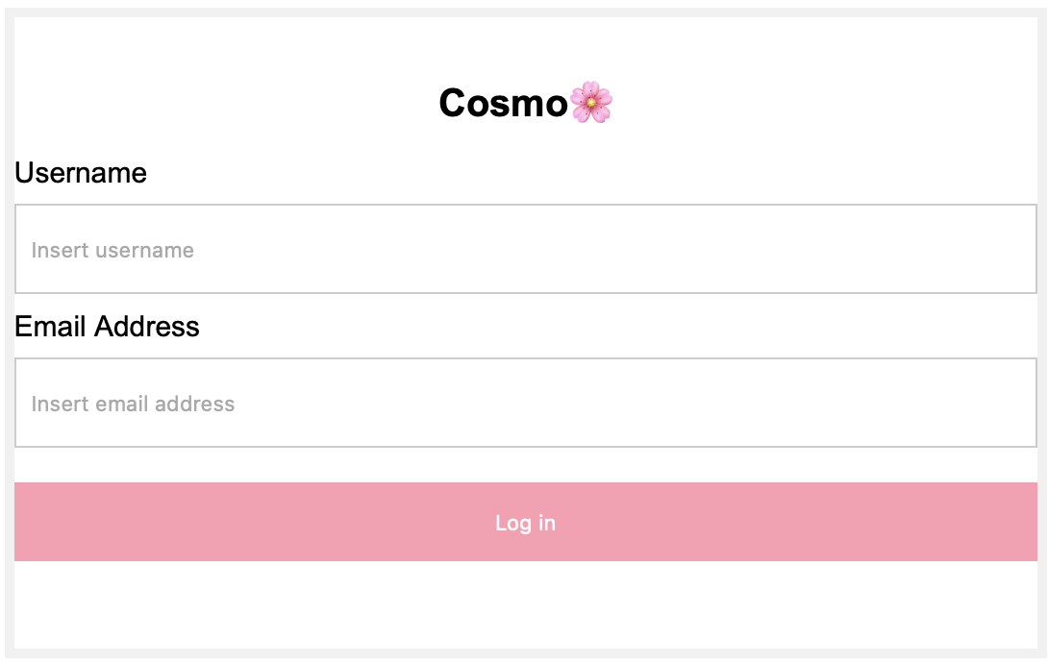
Website
UI
Sign UP / Log IN
USERNAME
EMAIL
NAME

Slide 14
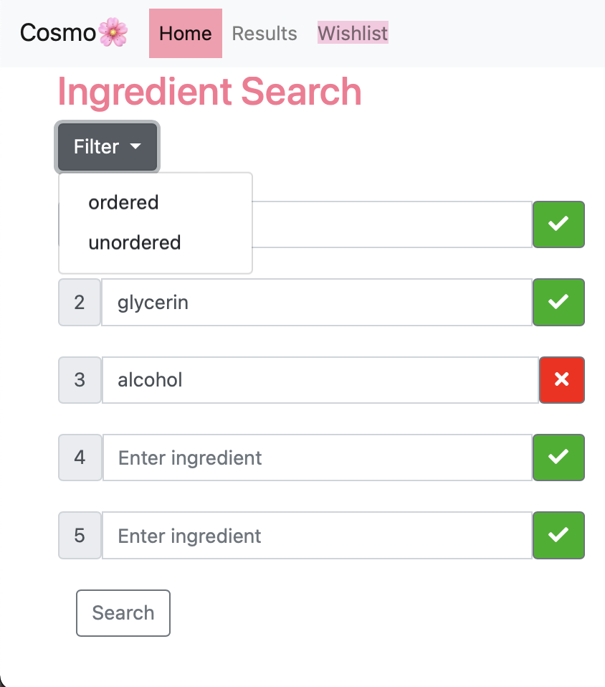
Website
UI
Home / Search
Include Ingredient
ordered
Unordered
Exclude Ingredient:
Unordered only
Notes:
When the button on the right side is toggled on the green ✅ "include" option, Cosmo will search for products containing this specific ingredient and take into account the state of the Filter button.
When the Filter button above the search fields is toggled on unordered, the search is done in an unspecified order. Otherwise, if it is on ordered, the number on the left of the search field corresponds to the position of the ingredient within the product ingredient list.
When the button on the right side is toggled on the red ❌ "exclude" option, Cosmo will search for products not containing this specific ingredient at all, that is without taking into account the state of the Filter button for this specific ingredient.

Slide 15
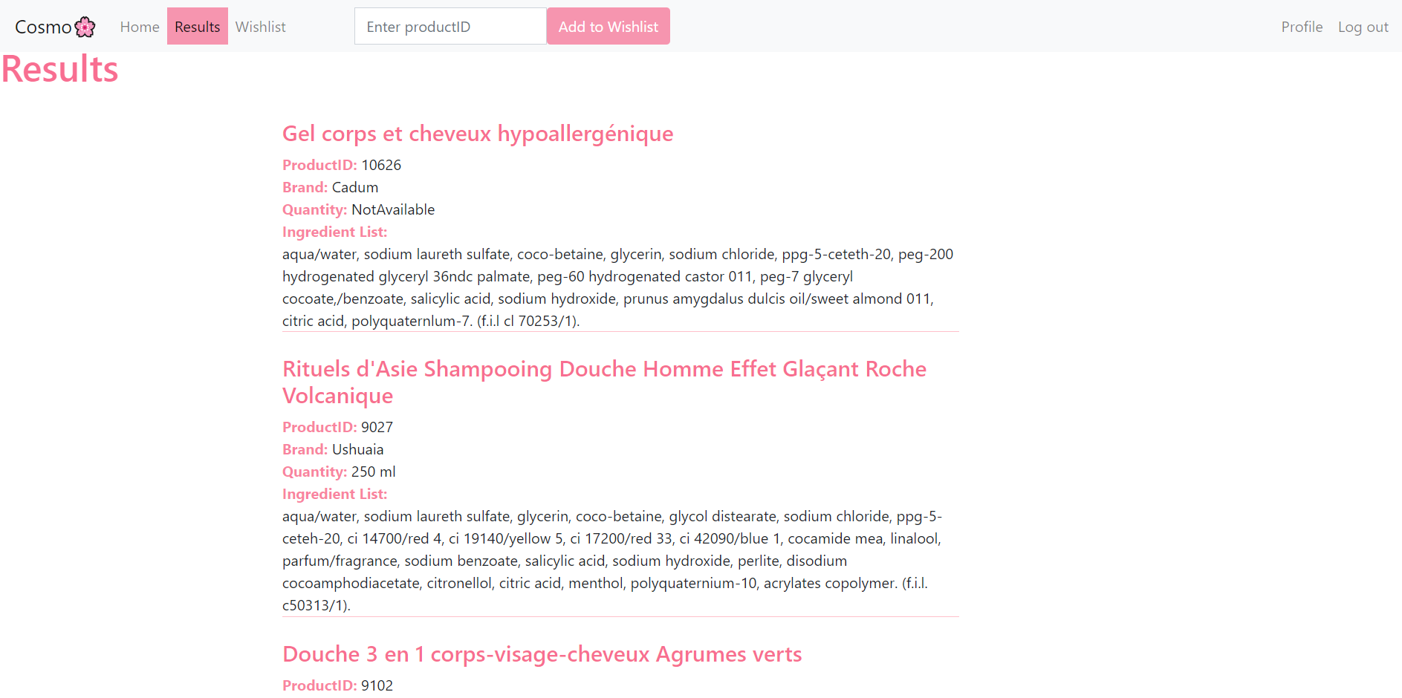
Website
UI
RESULTS

Slide 16
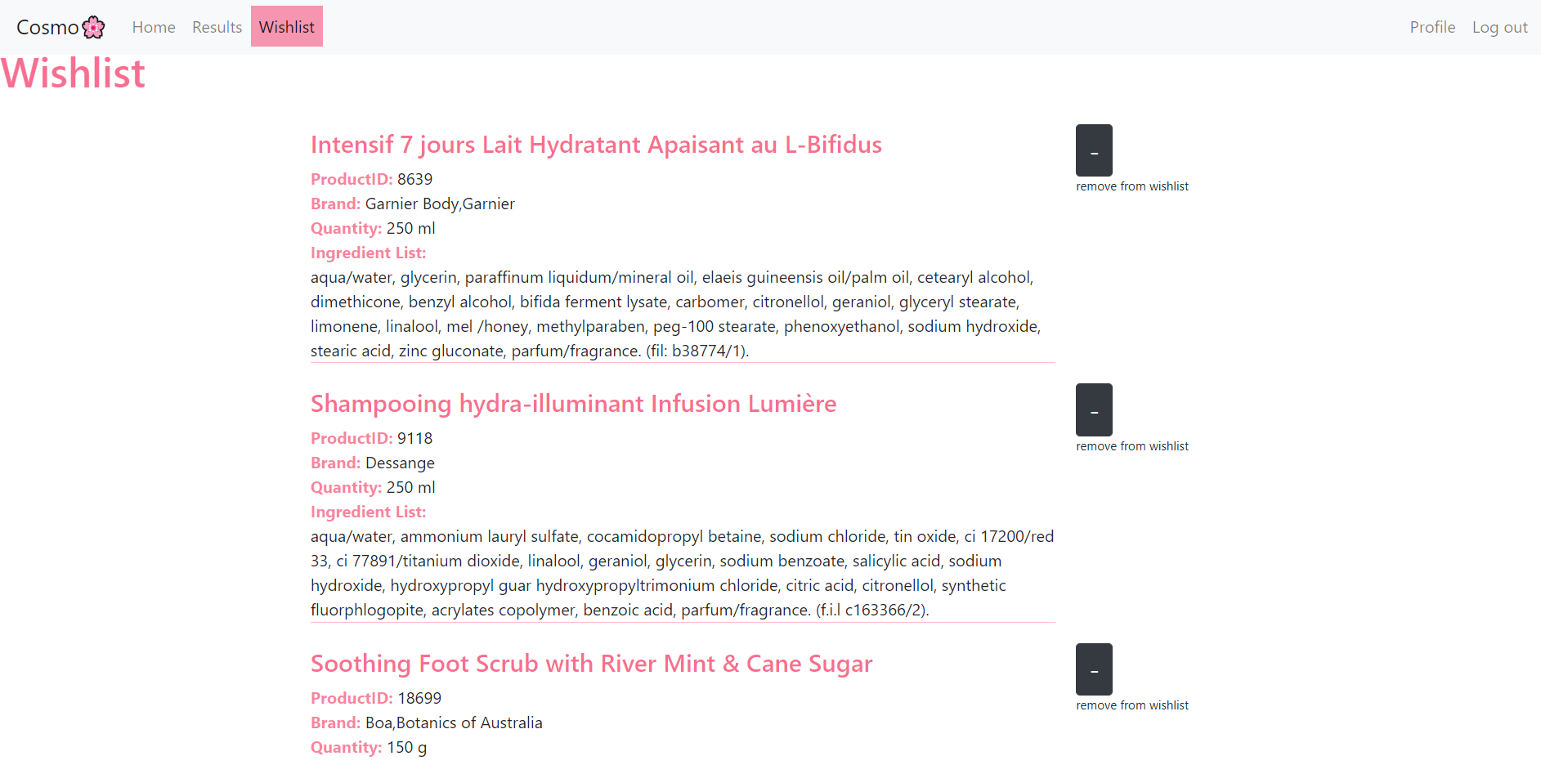
Wishlist
Website
UI

Slide 17
Testing
TestING Strategy
Mock UI
Products
Wishlist
Users
Tests
Products
Wishlist
Users
Unit tests
Integration Tests
Smoke Tests
Products
DB
Products
DB Utils
Mock
Products UI
Tests
Products
API
Website UI
Wishlist
DB Utils
Mock
Wishlist UI
Tests
Wishlist
Users &
Wishlist
DB
Users
DB Utils
Mock
Users UI
Tests
Users
Notes:
Creating a web app such as Cosmo as a team proved a very enriching, teaching and rewarding project, although sometimes challenging, both on a technical and interpersonal/organisational level. Our product is still a prototype, and could certainly be improved, but it fulfils our basic requirements, and other features could now be incrementally added to it.

Slide 18
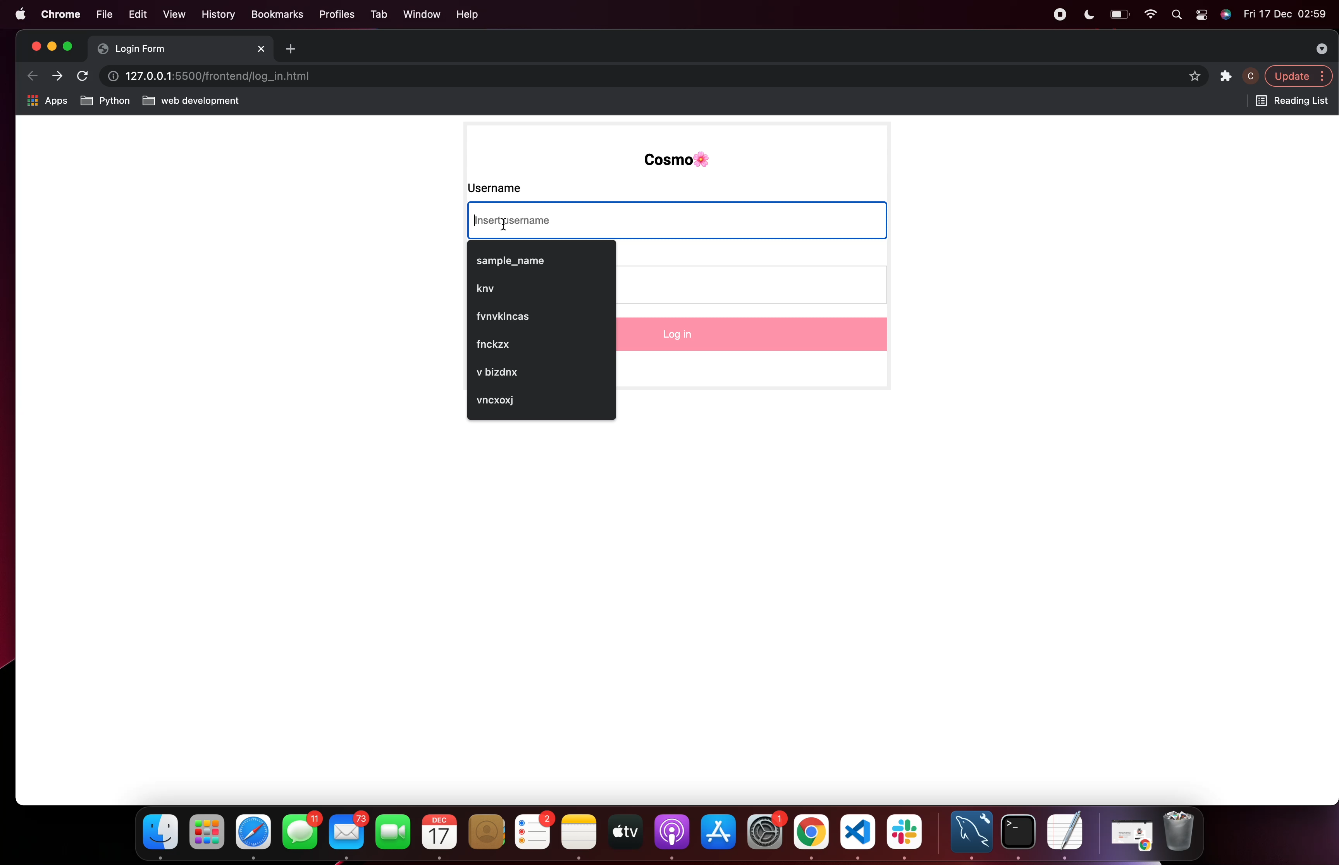
Demo 1
Demo

Slide 19
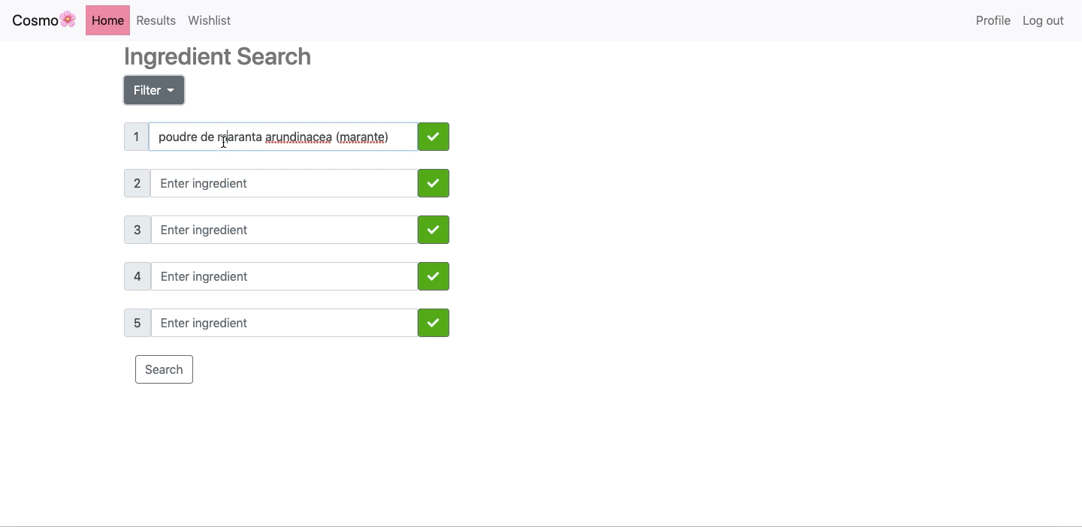
Demo 2
Demo

Slide 20
Conclusion
Agile
1-week sprints
Daily Scrum zoom meeting (before CFG lectures)
Weekly Sprint planning meetings (week-end)
Weekly Sprint Review & Retrospective meetings
Self-organising team
Scrum Master: role actually shared between members
Product Owner: ditto (we tried!)
Task-based sub-groups
review each other’s code
GitHub Branches
User-Stories
Incremental improvements (more to come!)
Notes:
Agile development (did team use any agile elements like iterative approach, refactoring, code reviews)
We strove to follow the Software Development Life Cycle (SDLC) framework and to implement Agile methodology. In particular, we had our Scrum Master organise Daily Scrum and weekly Sprint Planning meetings on Zoom. Through our Daily Scrum meeting, we updated each other on what we had been working, on the problems we encountered, and on what we were intending to work next. We also had longer meetings within our subgroups during which we mutually checked that our code worked as intended, reviewing or cleaning it up when necessary. We held long Sprint Review Meeting on Sundays, in which we reviewed the work we had done during the week, discussing what had been completed and what was left to complete during the next week. These meetings also gave us the opportunity ensure that our code was globally consistent.
We created "User Stories" to present features to implement in our product. We started by creating a very minimal core app with only a few functions, made sure that they worked, then incrementally improved our app.
Our team was split into task-based subgroups in which members reviewed each other's code. We managed our code with GitHub, and created a branch X_branch for each team member X to push their modifications on the remote repository for others to see. Before pushing our code to GitHub, we ensured that our code was consistent within our sub-groups.

Slide 21
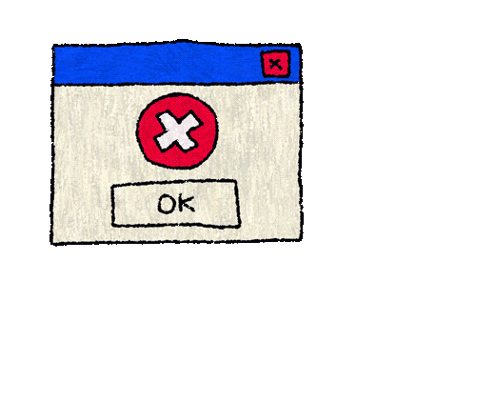

Conclusion
Conclusion
Very enriching, teaching & rewarding team project!
Sometimes challenging on a technical & organisational level
GiTHub confusion: conflicts, detached head state…
IDE unable to find modules just in front of IT
MySQL puzzled by mystery CSV codec errors
Task attribution between members, some sick!
Cosmo
Fulfils our basic requirements
Still a prototype, could be improved
New features could be added incrementally
Notes:
Creating a web app such as Cosmo as a team proved a very enriching, teaching and rewarding project, although sometimes challenging, both on a technical and interpersonal/organisational level. Our product is still a prototype, and could certainly be improved, but it fulfils our basic requirements, and other features could now be incrementally added to it.

Slide 22
Thank You!
Conclusion
Chizulum Nwizu
Claire BOITET
Georgia Woolley
Nasian Ahmed
Nikita Patel
Sophie Gilbert
🌸

Slide 23
TaskS
Cookies
TASK | Chizu | Claire | Georgia | Nasian | Nikita | Sophie
Products DB (Cosmo-OBF) | X | XXX |  |  |  | X
Users & Wishlist DB |  |  |  | XXX
Products DB_Utils & Config | XXX | XXX |  |  |  | XX
Users DB_Utils & Config |  |  |  |  | XXX | XX
Wishlist DB_Utils & Config |  |  |  | XXX
Products API | XX | XX |  |  |  | X
Users & Wishlist API |  |  |  |  | XX | XX
Tests |  |  |  | XXX |  | XXX
Backend Main (mock Front End for tests) |  |  |  | XX |  | XX
Front End Web UI | XXXX |  | X
Merging App | XX
Documentation & Presentation | X | XXXX |  | X | X | X

Slide 24



To be continued…
Cookies
NEXT STEP: Deploy Cosmo Online!
+
User Stories to be completed later
I would like to have a password so no one else can access my account
I would like to [know where to purchase] the products I select
I live in [London], I would like to only get results from [UK] stores
I want to avoid products sold in [a certain country]
I am only looking for [vegan] products
As a fanatic of [product W] which has been discontinued, I want to find [something as SIMILAR as possible ingredient-wise], so I can resume my normal hair routine ASAP

Slide 25




API
Cookies
3-in-1 API
Products (replaces experimental OBF API)
WiShlist
Users
Note:
We originally intended to use the OBF API but…
It was experimental, minimal and undocumented…
So we built our own to access a modified copy of their DB

